Slide 1
Indian Restaurants Analysis Chicago
By Amir Musallam

Slide 2
Intro
This project will focus on Indian restaurants in the Chicago land area which will be analyzed and rated using Foursquare. This will be market analysis to see what kind of competition exists in Chicago.

Slide 3
Data Acquisition
1. Chicago restaurant inspection data from 2010-2020
Data source : https://data.cityofchicago.org/api/views/4ijn-s7e5/rows.csv?accessType=DOWNLOAD
Description : This data set contains 137,907 rows and 17 columns with Restaurant Name, Street Name, violation descriptions along with their latitude and longitude. This data will be downloaded and used.
2. Ratings of Indian restaurants for selected locality in Chicago
Data source : Fousquare API
Description : By using this api we will get all the ratings for Indian restaurants in selected neighborhood

Slide 4
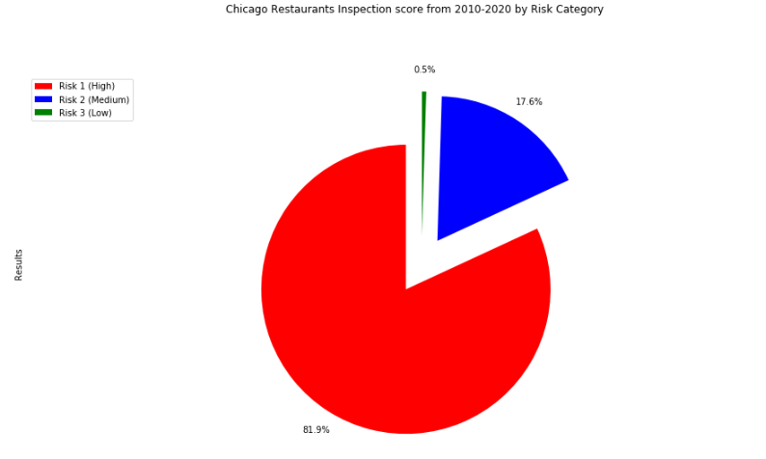
Chicago Restaurants Inspection Score from 2010-2020 by Risk Category

Slide 5
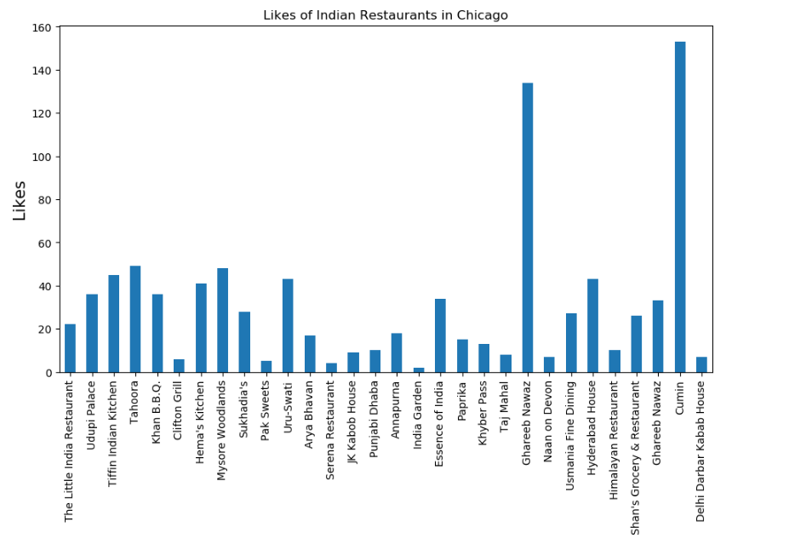
Likes of Indian Restaurants in Chicago
Cumin was the most liked Indian restaurant in Chicago based on Foursquare
Cumin also had an Average rating of 8.1

Slide 6
Conclusion
Chicago has quite a few Indian restaurants. However it does have the potential market for opening a new Indian restaurant
Roughly 80% of Indian restaurants that are currently present in Chicago are placed in high risk category based on the inspection data from 2010-2020.
The Indian restaurants in the Chicago were visualized using the folium map rendering library
Using Foursquare API, the venue details for the Indian restaurants were analyzed and found that among all the restaurants in Chicago - Cumin is the best place to dine.

